Slide 1
THE REVOLUTION’S
PROMISE
Today you will hear testimonies from interviews with Palestinian artists, as well as material available online.
The artist's stories in ‘The Revolution’s Promise’ are only a few of many.
People were interviewed separately, without knowing who else was being interviewed.
Each interviewee’s perspective, thoughts and ideas are solely their own.
Today’s event is organised by ADD YOUR ORGANISATION OR GROUP
and read by: ADD NAMES
The Revolution’s Promise is created by The Freedom Theatre & Artists On The Frontline
WWW.THEREVOLUTIONSPROMISE.COM
GET INVOLVED:

Slide 2
THE STORY
OF THE
FREEDOM
THEATRE
Jenin Refugee Camp
1929 - 1995

Slide 3
JULIANO MER KHAMIS
CO-FOUNDER & ARTISTIC DIRECTOR THE FREEDOM THEATRE

Slide 5
ARNA MER KHAMIS
ACTIVIST & TEACHER FOUNDER OF CARE & LEARNING
THE STONE THEATRE

Slide 7
AHMED TOBASI
ACTOR & DIRECTOR THE FREEDOM THEATRE

Slide 9
YOUSEF SWAITAT
YOUNG ACTING STUDENT THE STONE THEATRE

Slide 11
DREAMS OF
LIBERATION
Historical Palestine
One story of a filmmaker

Slide 12
MOHAMMAD BAKRI
ACTOR & DIRECTOR DIRECTOR OF ‘JENIN, JENIN’

Slide 14
THE STORY
OF THE
FREEDOM
THEATRE
Jenin Refugee Camp
2001- 2006

Slide 15
YOUSEF SWAITAT
YOUNG ACTING STUDENT THE STONE THEATRE

Slide 17
JULIANO MER KHAMIS
CO-FOUNDER & ARTISTIC DIRECTOR THE FREEDOM THEATRE

Slide 19
AHMED TOBASI
ACTOR & DIRECTOR THE FREEDOM THEATRE

Slide 21
ZAKARIA ZUBEIDI
CO-FOUNDER THE FREEDOM THEATRE

Slide 23
AHMED TOBASI
ACTOR & DIRECTOR THE FREEDOM THEATRE

Slide 25
BUILDING A
NATIONAL IDENTITY
Jerusalem
One woman’s fight to keep culture on the map

Slide 26
RANIA ELIAS
DIRECTOR
YABOUS CULTURAL CENTRE

Slide 28
TO BE OR
NOT TO BE
Aida Refugee Camp
Bethlehem
A photographer on the frontline

Slide 29
MOHAMMAD AL-AZZA
ARTIST & PHOTOGRAPHER LAJEE CULTURAL CENTRE

Slide 31
THE STORY
OF THE
FREEDOM
THEATRE
Jenin Refugee Camp
2006 - 2011

Slide 32
MARIAM ABU KHALED
ACTING STUDENT THE FREEDOM THEATRE

Slide 34
JULIANO MER KHAMIS
CO-FOUNDER & ARTISTIC DIRECTOR THE FREEDOM THEATRE

Slide 36
AHMED TOBASI
ACTOR & DIRECTOR THE FREEDOM THEATRE

Slide 38
PRISONS WITHIN PRISONS
MILITARY PRISONS ACROSS ISRAEL
Four separate stories, told at the same time

Slide 39
SUHAIL KHOURY
MUSICIAN & COMPOSER
GENERAL DIRECTOR OF
NATIONAL CONSERVATORY OF MUSIC

Slide 41
DAREEN TATOUR
WRITER, POET & PHOTOGRAPHER

Slide 43
LOAI TAFESH
DANCER & CHOREOGRAPHER FOUNDER NAQSH POPULAR ART TROUPE

Slide 45
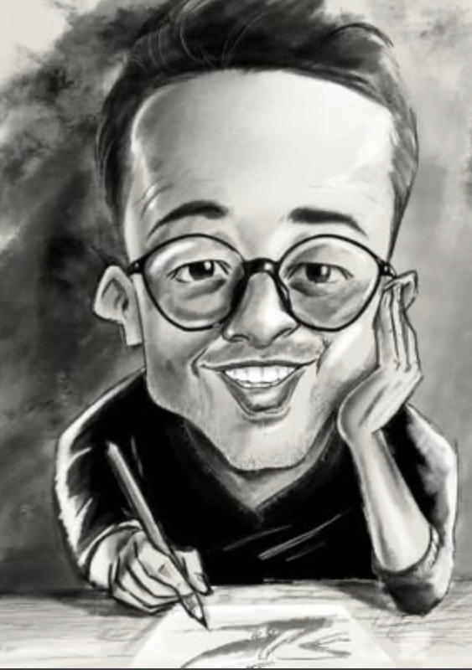
MOHAMMED SABAANEH
CARTOONIST

Slide 47
A MOMENT &
NINE MISSILES
GAZA
A theatre under attack

Slide 48
ALI ABU YASEEN
ACTOR, WRITER & DIRECTOR,
CO-FOUNDER AL-MISHAL CULTURAL CENTRE

Slide 50
BOYCOTT
DIVESTMENT
SANCTIONS
Worldwide
Diversity of Tactics

Slide 51
OMAR BARGHOUTI
CO-FOUNDER BOYCOTT, DIVESTMENT, SANCTIONS

Slide 53
THE STORY
OF THE
FREEDOM
THEATRE
Jenin Refugee Camp
2011

Slide 54
JULIANO MER KHAMIS
CO-FOUNDER & ARTISTIC DIRECTOR THE FREEDOM THEATRE

Slide 56
AHMED TOBASI
ACTOR & DIRECTOR THE FREEDOM THEATRE

Slide 58
THE REVOLUTION’S
PROMISE
A global solidarity project
GET INVOLVED:
WWW.THEREVOLUTIONSPROMISE.COM

